Slide 1
Update on Homework Conversations
May 15, 2019

Slide 2
Discussion Venues
Professional Development
Individual & grade level meeting conversations
Late Start Meetings
Staff Meetings
1:1 check-ins about homework
School Site Council (Parents/staff)
Parent discussions during Student Study Team
Advisory Meeting (BBHS)
Online surveys

Slide 3
Topics Discussed
Main focus of homework
Importance of modification
Individualized homework
Support at home (ie. language barriers)
Reflections from teachers on homework practices
Homework amount, purpose and time required to complete
Grading practices regarding homework
D & F List
Board Policy
Student Handbook

Slide 4
Outcomes
A better understanding of the purpose of homework
Modification of homework for students to meet individual needs
Student handbooks match Board Policy
More reflective conversations by teachers
Assigning homework that can be completed by students independently
More awareness of home support
Greater home/school communication
Notes:
Students have access to Edmentum and their syllabi, if they choose to complete homework at home

Slide 5
Outcomes
Discussions now include:
  Impact of homework on student stress levels
  Recognize students responsibilities outside of school
  Creating support for students
Notes:
Working to help support family income

Slide 6
Positive Changes
Creation of a math spiral review that will be the foundation of any homework assigned
Addressing homework on the WASC document for 2019-2020
Individual conversations with teachers (particularly new staff) to help with focus & understanding of best homework practices

Slide 7
Next Steps...
Continue creating spiral review for math homework (MS)
Continued conversations with all stakeholders for input on current practices
Send out email and call outs encouraging parents/guardians to complete the district survey
Notes:
83 to 144 hopefully more

Slide 8
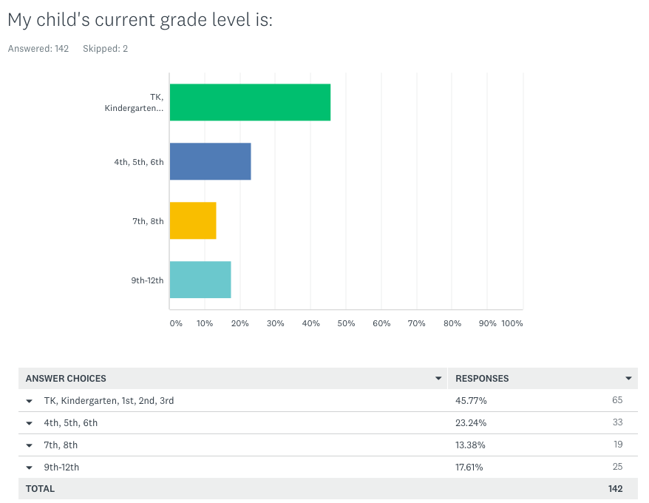

Slide 9
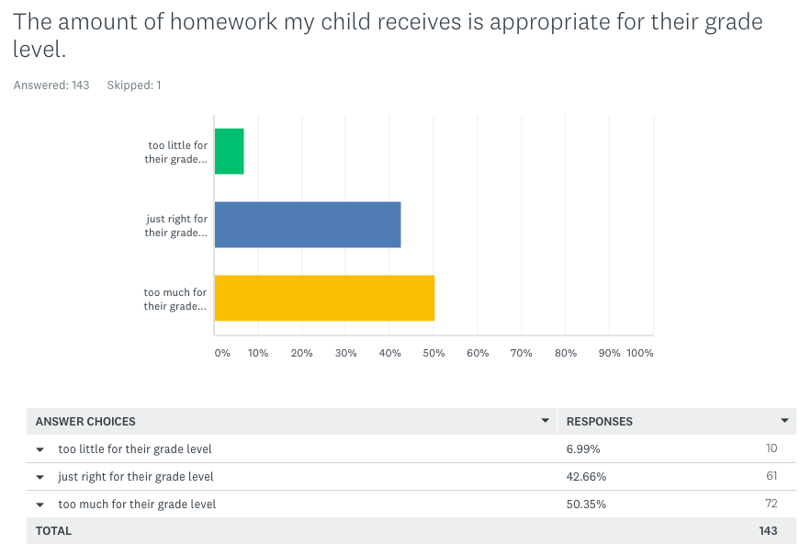
Notes:
Too much: Tk - 3rd (65 responses) = 32 (50/50) 4th - 6th (33 responses) = 12% too little, 45% just right, 42% too much 7th-8th (19 responses)= 16% too little, 37% just right,
47% too much, 9 - 12th (25 respondents) 8% too little, 32% just right, 60% too much.

Slide 10
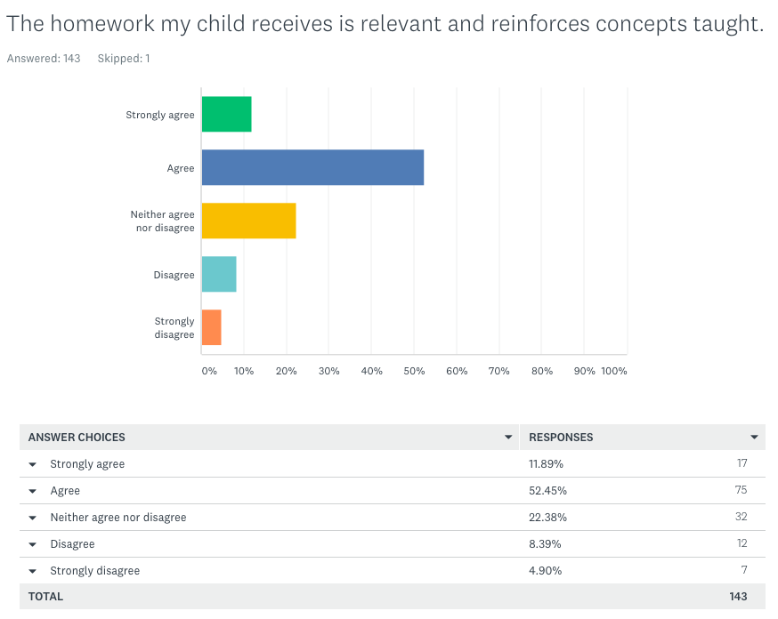
Notes:
Tk- 3rd (64 Responses) 14% strongly agree, 59% agree, 17% neither agree or disagree, 5% disagree, 5% strongly disagree
4th-6th (Responses) 9%Strongly agree, 55%agree, 24% neither agree or disagree. 9% disagree, 3% strongly disagree
7th-8th (19 Responses) 16%Strongly agree, 42%agree, 10% neither agree or disagree. 21% disagree, 10% strongly disagree
9th- 12th (25 Responses) 8%Strongly agree, 36%agree, 44% neither agree or disagree. 8% disagree, 4% strongly disagree (Too much but relevant)

Slide 11
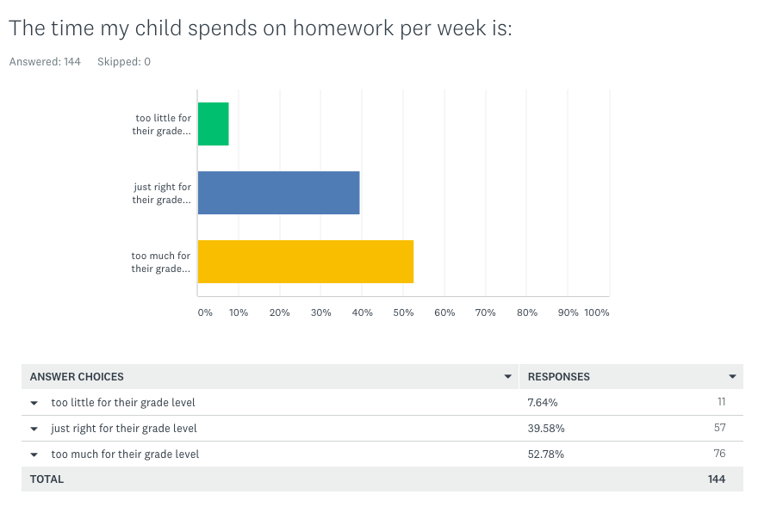
Notes:
Too much: Tk - 3rd (65 responses) = 31 (48/52%) 4th - 6th (33 responses) = 15% too little, 33% just right, 51% too much 7th-8th (19 responses)= 16% too little, 32% just right, 53% too much, 9 - 12th (25 respondents) 4% too little, 32% just right, 64% too much.

Slide 12
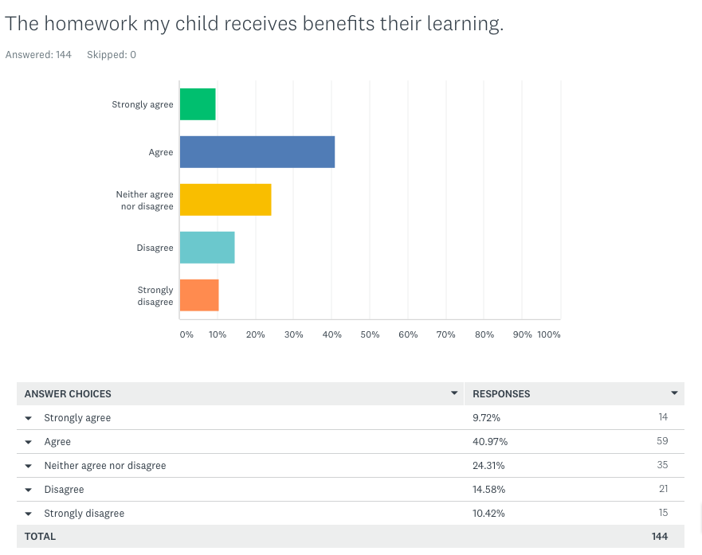
Notes:
Tk- 3rd (64 Responses) 11% strongly agree, 52% agree, 14% neither agree or disagree, 15% disagree, 8% strongly disagree (63% AGREE)
4th-6th (Responses) 6%Strongly agree, 42%agree, 27% neither agree or disagree. 12% disagree, 12% strongly disagree (48% AGREE)
7th-8th (19 Responses) 16%Strongly agree, 26%agree, 32% neither agree or disagree. 11% disagree, 16% strongly disagree (42% AGREE)
9th- 12th (25 Responses) 8%Strongly agree, 24%agree, 40% neither agree or disagree. 16% disagree, 12% strongly disagree (Too much but relevant) (32% AGREE)

Slide 13
Summary
Majority of parents believe that homework is relevant and reinforces concepts taught
Majority of parents believe that homework benefits their student’s learning
Parent concerns about homework are being discussed and addressed at the school sites
Parents are split 50/50 on amount of homework that is assigned
Notes:
50/50 In elementary is 50% and 42% but MS is 47% but HS 60% amount of homework

